Slide 1







Visual Curiosity
Learning to Ask Questions to Learn Visual Recognition
Jianwei Yang*, Jiasen Lu*, Stefan Lee, Dhruv Batra, Devi Parikh
Notes:
If you are reading this, I plugged my laptop in too soon! ☺ Hi CoRL!

Slide 2
Imagine you’ve just purchased a domestic robot…
c
C-BOT
Brand New
Home Robot
Notes:
I would like to start by asking you to imagine that in the not-so-distance future you purchase a domestic robot to assist around the house …

Slide 3

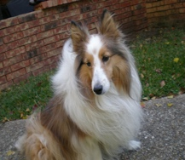
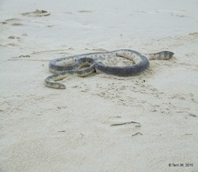
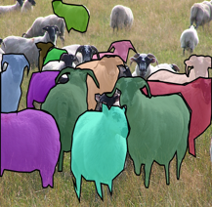
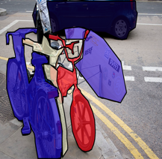
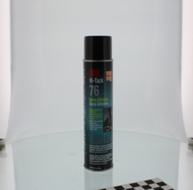
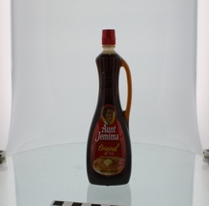
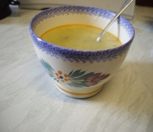
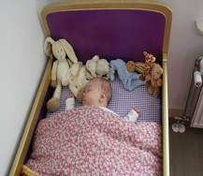
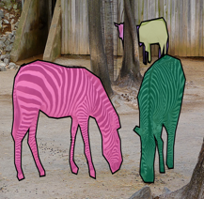
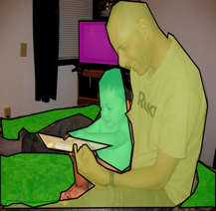
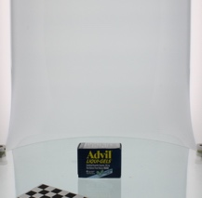
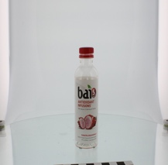
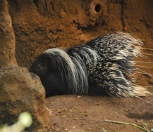
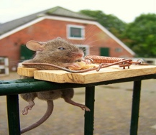
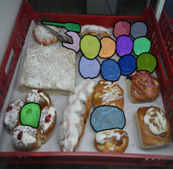

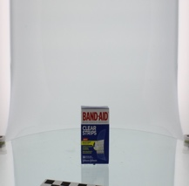
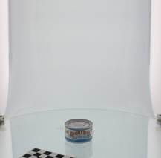
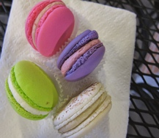
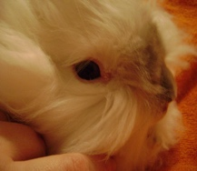
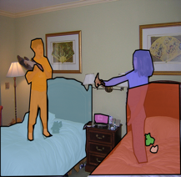
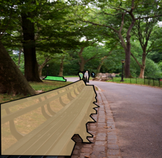
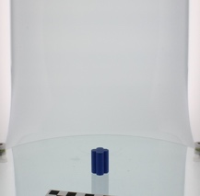
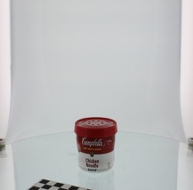
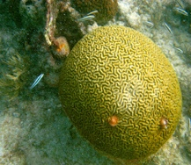
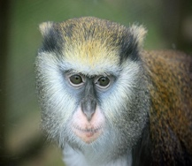
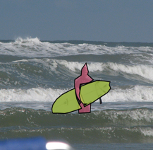
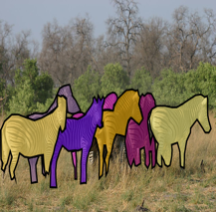
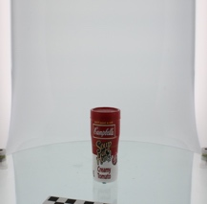
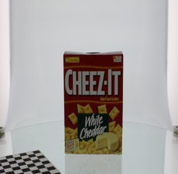
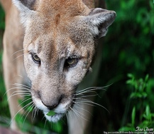
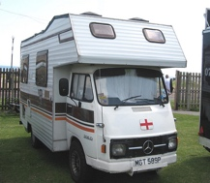
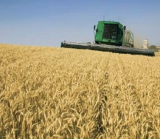
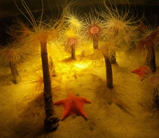
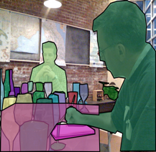
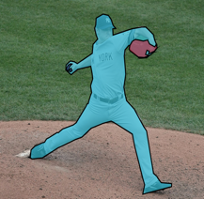
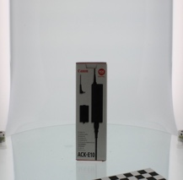
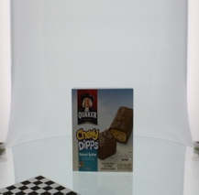
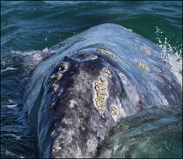
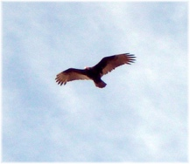
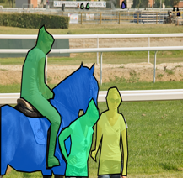
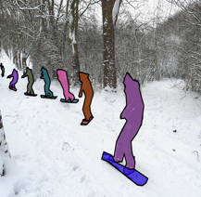
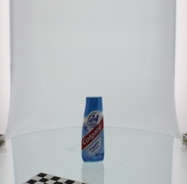
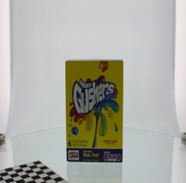
… and before you bring it home from the factory
ImageNet
COCO
BigBird
c
Visual Recognition Software
C-BOT
Brand New
Home Robot
Notes:
And before you bring it home, the factory installs cutting edge visual recognition software based on this ‘deep learning’ thing you keep hearing about – loading up models trained on all the standard datasets.

Slide 4
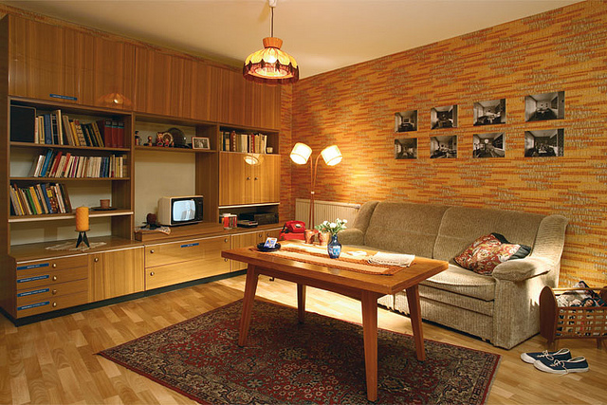
You finally get your new robot home and …
c
C-BOT
Brand New
Home Robot
Notes:
You finally get your new robot home and it looks around and…

Slide 5



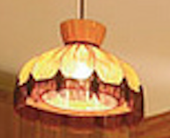
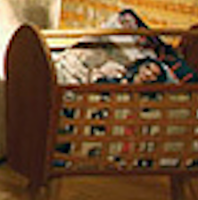
… it has no idea about some things in your house.
c
C-BOT
Brand New
Home Robot
Notes:
It has no idea about some things in your home. For instance, its never seen a candle. It knows what books are but you insist on calling these red ones Encyclopedias. It’s never seen a lamp this tacky and this `thing` is only a magazine bin because it’s a bin full of magazines! No training set in the world could have prepared an agent for life with you!
This scenario is a specific instance of the general open-world recognition problem..

Slide 6
The Open-World Recognition Problem
In an open-world setting, an intelligent agent will encounter visual objects, attributes or relationships it does not recognize.
c
C-BOT
Brand New
Home Robot
Notes:
Namely, that no matter how well trained, an agent in an open-world setting will inevitably encounter objects, attributes, or relationships it does not recognize.

Slide 7

How can an agent learn about these concepts?
What is the orange object to the left of the television?
c
C-BOT
That’s a candle.
Brand New
Home Robot
Human
(Oracle)
Notes:
The question then is how can agents learn about these concepts in the environments themselves. A natural answer is for the agent to communicate with its owner. For instance, the agent could ask the question “what is the orange object to the left of the television?” in order to learn about the candle.

Slide 8
Asking informative questions is challenging!
What is the orange object to the left of the television?
c
C-BOT
That’s a candle.
Brand New
Home Robot
Human
(Oracle)
Notes:
However, asking informative and unambiguous questions is a challenging task in its own right!
Breaking down this sample question:
- the agent has leveraged partial information it does recognize about the novel object – the fact that its orange,
it has also grounded the television,
and used it to spatially reference the unknown object
This brings us to the key question we address in this work …

Slide 9
Asking informative questions is challenging!
How to train an agent to ask questions about its surroundings to improve its recognition capabilities?
What is the orange object to the left of the television?
c
C-BOT
That’s a candle.
Brand New
Home Robot
Human
(Oracle)
Notes:
How can we train agents to ask questions about their surroundings to improve their recognition capabilities?

Slide 10
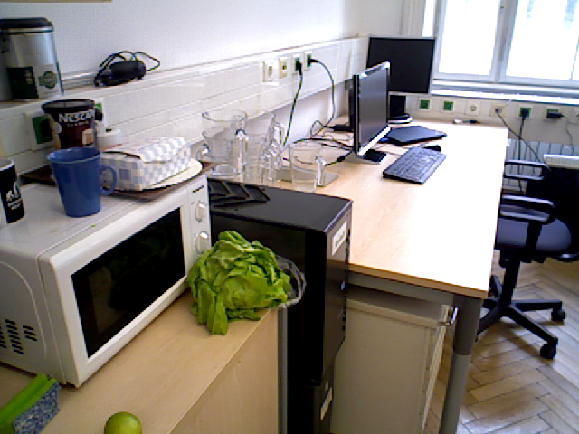
Learning to Ask Questions to Learn Visual Recognition
Goal: Learn a question asking policy that can ask informative questions about novel concepts in new environments in order to quickly train a visual system.
A successful policy must:
Recognize if concepts are unknown
Leverage existing knowledge to formulate informative questions
c
What is the blue object?
Update the visual system based on human/oracle responses
Mug.
C-BOT
Notes:
This problem, which we call ‘Learning to Ask Questions to Learn Visual Recognition” seeks to train an agent that can ask informative questions about _novel_ concepts in _new_ environments in order to quickly train a visual system.
In order to succeed, a policy must recognize if concepts are known or unknown. Realizing the two objects outlined in red are unknown in this example
Then it must leverage existing knowledge in asking questions, relying on its understanding of `blue` to reference the unrecognized mug.
Finally it must update its visual system based on the response and repeat this cycle.

Slide 11
Learning to Ask Questions to Learn Visual Recognition
Goal: Learn a question asking policy that can ask informative questions about novel concepts in new environments in order to quickly train a visual system.
A successful policy must:
Recognize if concepts are unknown
Leverage existing knowledge to formulate informative questions
c
What is to the right of the blue mug?
Update the visual system based on human/oracle responses
Box.
C-BOT
Notes:
For instance, using its new understanding of ’mug’ to reference the still unknown box.

Slide 12
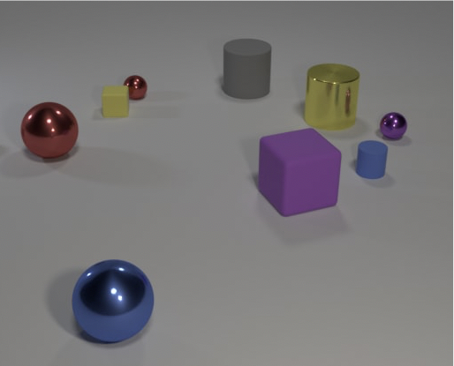
Learning to Ask Questions to Learn Visual Recognition
c
C-BOT
Notes:
In order to study this problem, we represent a home environment through a series of still images and replace the human respondent with an oracle that answers based on the ground truth annotations.

Slide 13

Learning to Ask Questions to Learn Visual Recognition
Agent: Asks a question
Oracle: Gives an answer
What color is the forward most object?
c
Blue.
C-BOT
Oracle
Notes:
At the most basic level of interaction, the agent asks a question about the environment and the oracle answers it.

Slide 14
Learning to Ask Questions to Learn Visual Recognition
What color is the forward most object?
For round in dialog:
Blue.
Agent: Asks a question
Oracle: Gives an answer
What shape is the blue metallic object?
+1
c
Update visual system
Sphere.
C-BOT
Oracle
Notes:
This back-and-forth repeats to form a dialog about this particular view during which the questioning agent collects as much information as possible. Afterwards, the visual system is updated based on the dialog.

Slide 15
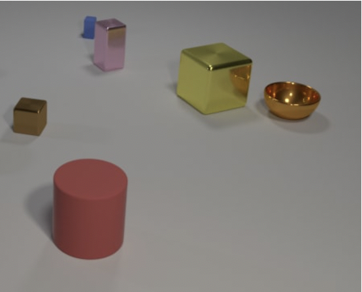
Learning to Ask Questions to Learn Visual Recognition
For environment in episode:
For round in dialog:
Agent: Asks a question
Oracle: Gives an answer
c
Update visual system
C-BOT
Oracle
Notes:
This query and update process repeats over multiple environments throughout an episode – simulating repeated interaction with a user in multiple environments.
So this is what we would like the questioner to be able to do.

Slide 16


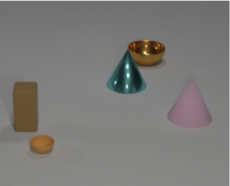
Learning to Ask Questions to Learn Visual Recognition
For episode in training:
Initialize visual system
For environment in episode:
c
For round in dialog:
C-BOT
Agent: Asks a question
Oracle: Gives an answer
Update visual system
c
Update question policy
C-BOT
Questioner must generalize to both new vision systems and new environments
Notes:
In order to train the questioner policy, we repeat this process over multiple episodes and randomly initialize the visual system at the start of each – essentially forcing the questioner to retrain it each time. At the end of each episode, the questioner policy is updated depending on how well it collected information over the episode.
In effect, we demonstrate a sort of ‘double’ generalization – our question generation policy must learn to generalize to new environments and new visual systems.

Slide 17
Learning to Ask Questions to Learn Visual Recognition
For episode in training:
Initialize visual system
For environment in episode:
For round in dialog:
Agent: Asks a question
Oracle: Gives an answer
Update visual system
Update question policy
Notes:
Looking closer at this problem setting, some components should seem familiar.

Slide 18
Learning to Ask Questions to Learn Visual Recognition
For episode in training:
Initialize visual system
For environment in episode:
For round in dialog:
Agent: Asks a question
Oracle: Gives an answer
Active Learning
By Asking Questions
Update visual system
Update question policy
Notes:
The inner loop is akin to an active learning problem in which labels are queried through asking questions. Note that unlike traditional active learning, the agent only receives additional label information when it asks unambiguous questions.

Slide 19
Learning to Ask Questions to Learn Visual Recognition
For episode in training:
Initialize visual system
For environment in episode:
For round in dialog:
Meta-Learning to
train the Questioner
Agent: Asks a question
Oracle: Gives an answer
Active Learning
By Asking Questions
Update visual system
Update question policy
Notes:
The outer loop resembles a meta-learning approach where the questioner must learn to train the visual model and ask intelligent questions at varied levels of visual system competency and in differing environments.

Slide 20
A Subset of Related Work
Meta-Active Learning
Bachman et al. Learning algorithms for active learning. 2017.
Contardo et al. A meta-learning approach to one-step active learning. 2017.
Fang et al. Learning how to active learn: A deep reinforcement learning approach. 2017.
Learning Grounding through Language based Interaction
Thomason et al. Opportunistic active learning for grounding natural language descriptions. 2017.
Lutkebohle et al. The curious robot-structuring interactive robot learning. 2009.
Yu et al. Learning how to learn: an adaptive dialogue agent for incrementally learning visually … . 2017.
Skočaj et al. An integrated system for interactive continuous learning of categorical knowledge. 2016.
Active Learning by Asking Questions
Misra et al. Learning by Asking Questions. 2018.
Notes:
Before we get to our approach and some experiments, I wanted to point to some other related work to check out.
The area of Meta-Active Learning has had a good amount of recent interest, primarily on standard supervised learning tasks like image classification.
Likewise there are a string of works learning visual grounding through language based interactions.
And recent work has focused on an active learning approach to visual question answering based on asking questions.

Slide 21

Agent Architecture
Image
Same Content
Image
Question Generator
Visual System
Visual Memory
Oracle/Human
Agent
Notes:
We move now to our model architecture. At the start of a dialog, the input image is passed through the visual system which produces estimates of object attributes which is used to initialize the visual memory. The visual memory is then used as context for the question generator which asks a question to the oracle. The oracle answers and the visual memory is updated. This ask-answer-update loop repeats for the dialog and then the visual system is updated based on the final visual memory.
Lets look more closely at each module starting with the visual system...

Slide 22
Agent Architecture
Visual System
Image
Same Content
Image
Spatial
Relationships
Question Generator
6
5
3
2
Visual Memory
4
Oracle/Human
Attribute Distributions
Answer Digestor
1
Agent
Visual Graph
Notes:
To simplify the problem, the visual system is a small convolutional network that takes as input the image and ground truth bounding boxes and generates a graph representation of the scene with nodes corresponding to objects and their predicted attribute distributions and edges to spatial relationships such as `left of` or `behind`.

Slide 23
Agent Architecture
Image
Same Content
Image
Question Generator
Visual System
Visual Memory
Oracle/Human
Agent
Notes:
Moving to the visual memory

Slide 24
Agent Architecture
Visual Memory
Image
Same Content
Image
Question Generator
Visual System
Oracle/Human
Visual Graph
Answer Digestor
Memory Graph
Agent
Notes:
The visual memory acts as a working memory for the agent and aggregates information coming from the visual system as well as the answers given during the dialog.
To initialize the graph memory, the graph produced by the visual system is thresholded in a bottom-up update step questions.

Slide 25
Agent Architecture
Visual Memory
Image
Same Content
Image
Bottom-Up Update
Question Generator
Visual System
Oracle/Human
Visual Graph
Answer Digestor
Memory Graph
Agent

Slide 26
Agent Architecture
Visual Memory
Image
Same Content
Image
Q: What is the color of the right most object?
Question Generator
A: Orange
Visual System
Oracle/Human
Memory Graph
Answer Digestor
Agent
Notes:
Similarly, given a question and answer pair from the dialog, the memory graph is updated in a top-down fashion.

Slide 27
Agent Architecture
Visual Memory
Image
Same Content
Image
Top-Down Update
Q: What is the color of the right most object?
Question Generator
A: Orange
Visual System
Oracle/Human
Memory Graph
Answer Digestor
Agent
Notes:
Simply assigning the answer to the queried object.

Slide 28
Agent Architecture
Image
Same Content
Image
Question Generator
Visual System
Visual Memory
Oracle/Human
Agent
Notes:
Finally the Question Generator

Slide 29








Agent Architecture
Question Generator
Image
Same Content
Image
$$h_{i,t−1}^{}$$
Questioner Action Space
Questioner Policy
$$τ_{i}^{t}$$
Target Object
Visual Memory
$$G_{i,t−1}^{m}$$
$$q_{i}^{t}=\{τ_{i}^{t},a_{i}^{t},r_{i}^{t}\}$$
$$a_{i}^{t}$$
Target Attribute
Dialog Rounds
$$q_{i}^{t−1},a_{i}^{t−1}$$
Question
Visual System
Visual Memory
$$r_{i}^{t}$$
Reference Object
Previous QA
Oracle/Human
$$h_{i,t}^{}$$
Answer Digestor
Agent
Notes:
The question generator takes in the current state of the dialog and selects a question action.
Specifically, the question generator is a recurrent policy network that takes as input the current visual memory, the previous question-answer pair, and a hidden state encoding the dialog history – and outputs a question tuple.
This tuple is a set of three discrete outputs corresponding to the target object being asked about, the target attribute that is being queried for that object, and possibly an object to be used as a spatial reference. These outputs are used to generate a question according to a set of templates.

Slide 30
Question Templates
6
Graph Memory
Color: UNK | Size: UNK
Shape: UNK | Mat: UNK
5
6
3
2
Color: UNK | Size: UNK
Shape: cube | Mat: UNK
Color: Pink | Size: Small
Shape: Cube | Mat: UNK
4
4
5
1
3
Color: UNK | Size: UNK
Shape: Cube | Mat: Metal
Color: Red | Size: Large
Shape: UNK | Mat: UNK
Color: UNK | Size: Small
Shape: UNK | Mat: UNK
2
1
Notes:
Lets look at how these actions translate to questions. Consider the following image and graph memory.

Slide 31
Question Templates
6
Graph Memory
Color: UNK | Size: UNK
Shape: UNK | Mat: UNK
5
6
3
2
Color: UNK | Size: UNK
Shape: cube | Mat: UNK
Color: Pink | Size: Small
Shape: Cube | Mat: UNK
4
4
5
1
3
Color: UNK | Size: UNK
Shape: Cube | Mat: Metal
Color: Red | Size: Large
Shape: UNK | Mat: UNK
Color: UNK | Size: Small
Shape: UNK | Mat: UNK
2
1
Target | 1
Attribute | Shape
Reference | None
Question | What is the shape of the front most large red object?
Notes:
For target object 1, attribute shape, and reference none -- the zero-hop question “What is the shape of the front most large red object?” is generated. Note that the attributes known in the graph memory (color and size in this instance) are used in the question.

Slide 32
Question Templates
6
Graph Memory
Color: UNK | Size: UNK
Shape: UNK | Mat: UNK
5
6
3
2
Color: UNK | Size: UNK
Shape: cube | Mat: UNK
Color: Pink | Size: Small
Shape: Cube | Mat: UNK
4
4
5
1
3
Color: UNK | Size: UNK
Shape: Cube | Mat: Metal
Color: Red | Size: Large
Shape: UNK | Mat: UNK
Color: UNK | Size: Small
Shape: UNK | Mat: UNK
2
1
Target | 1
Attribute | Shape
Reference | None
Question | What is the shape of the front most large red object?
3
Color
2
What is the color of the metal cube on the left side of a small object?
Notes:
If the target is object 3’s color and object 2 is used as a reference, the question “What is the color of the metal cube on the left side of a small object?” is generated, again using existing information in the graph memory.

Slide 33
Question Templates
6
Graph Memory
Color: UNK | Size: UNK
Shape: UNK | Mat: UNK
5
6
3
2
Color: UNK | Size: UNK
Shape: cube | Mat: UNK
Color: Pink | Size: Small
Shape: Cube | Mat: UNK
4
4
5
1
3
Color: UNK | Size: UNK
Shape: Cube | Mat: Metal
Color: Red | Size: Large
Shape: UNK | Mat: UNK
Color: UNK | Size: Small
Shape: UNK | Mat: UNK
2
1
Target | 1
Attribute | Shape
Reference | None
Question | What is the shape of the front most large red object?
3
Color
2
What is the color of the metal cube on the left side of a small object?
5
Material
3
What is the material of object at left side of metal cube?
Notes:
Similarly the 5th object’s material is queried with the 3rd object as reference. For full details of question templates, please see the paper.

Slide 34
Oracle Question Answering
6
Oracle Graph
Color: Teal | Size: Small
Shape: Cylinder | Mat: Rubber
5
6
3
2
Color: Yellow | Size: Small
Shape: Cube | Mat: Metal
Color: Pink | Size: Small
Shape: Cube | Mat: Metal
4
4
5
1
3
Color: Yellow | Size: Large
Shape: Cube | Mat: Metal
Color: Red | Size: Large
Shape: Cylinder | Mat: Rubber
Color: Orange | Size: Small
Shape: Bowl | Mat: Metal
2
1
Notes:
Now that we have questions, we need the oracle to answer them. Because the oracle has access to the ground truth graph, answering questions boils down to executing the functional form of the question.

Slide 35
Oracle Question Answering
6
Oracle Graph
Color: Teal | Size: Small
Shape: Cylinder | Mat: Rubber
5
6
3
2
Color: Yellow | Size: Small
Shape: Cube | Mat: Metal
Color: Pink | Size: Small
Shape: Cube | Mat: Metal
4
4
5
1
3
Color: Yellow | Size: Large
Shape: Cube | Mat: Metal
Color: Red | Size: Large
Shape: Cylinder | Mat: Rubber
Color: Orange | Size: Small
Shape: Bowl | Mat: Metal
2
1
Q: What is the color of the front most object?
A: Red
Notes:
For instance, the question ‘what is the color of the front most object?’ resolves to a unique node (node 1) and the oracle replies with that node’s color.

Slide 36

Oracle Question Answering
6
Oracle Graph
Color: Teal | Size: Small
Shape: Cylinder | Mat: Rubber
5
6
3
2
Color: Yellow | Size: Small
Shape: Cube | Mat: Metal
Color: Pink | Size: Small
Shape: Cube | Mat: Metal
4
4
5
1
3
Color: Yellow | Size: Large
Shape: Cube | Mat: Metal
Color: Red | Size: Large
Shape: Cylinder | Mat: Rubber
Color: Orange | Size: Small
Shape: Bowl | Mat: Metal
2
1
Q: What is the color of the front most object?
A: Red
Q: What is the shape of the object left of the green object?
A: Invalid
Notes:
However, not all questions are valid. ”What is the shape of the object left of the green object” for instance does not resolve to any nodes because there are no green objects and so the oracle replies with Invalid.

Slide 37


Oracle Question Answering
6
Oracle Graph
Color: Teal | Size: Small
Shape: Cylinder | Mat: Rubber
5
6
3
2
Color: Yellow | Size: Small
Shape: Cube | Mat: Metal
Color: Pink | Size: Small
Shape: Cube | Mat: Metal
4
4
5
1
3
Color: Yellow | Size: Large
Shape: Cube | Mat: Metal
Color: Red | Size: Large
Shape: Cylinder | Mat: Rubber
Color: Orange | Size: Small
Shape: Bowl | Mat: Metal
2
1
Q: What is the color of the front most object?
A: Red
Q: What is the shape of the object left of the green object?
A: Invalid
Q: What is color is the small cube?
A: Ambiguous
Notes:
At the other extreme, the question “What color is the small cube?” resolves to more than one node in the graph (both 4 and 5 are small cubes) and is therefore ambiguous. < >

Slide 38
Agent Architecture
Image
Same Content
Image
Question Generator
Visual System
Visual Memory
Oracle/Human
Agent
Notes:
The covers our agent and the oracle. The model has two trainable components, the visual system and question generator.

Slide 39





Training Objectives: Visual System
Cross-Entropy loss between the graph memory and the visual predictions over all images, objects, and attributes
$$θ_{v}^{∗}=\arg{\min{−\sum_{I_{i}∈I}{ \sum_{k=1 }^{K_{i}}{\log\left(\begin{matrix} \\ \end{matrix} \right) }}}}$$
Visual attribute predictions
Graph memory
Update visual system after each dialog with stochastic gradient descent
Notes:
In order to train the visual system, we apply a cross-entropy loss between the graph memory collected by the questioner and the predictions made by the visual system. This loss is taken over all images and objects.
Recall that we update the visual system after each dialog by taking a single step of stochastic gradient descent

Slide 40

Training Objectives: Questioner Policy
Train the questioner to maximize expected reward over images and dialog rounds in an episode
Sum of reward over all images and dialog rounds
$$θ_{π}^{∗}={\arg{\max{E_{V}E_{I\sim ℰ}}}}E_{π_{q}}\left[\sum_{i=1}^{n}{\sum_{t=1}^{T}{r_{i}^{t}(q_{i}^{t}\sim π_{q}(h_{i}^{t};θ_{π})}}\right]$$
Expectation over visual systems, episodes, and questions
Use A2C and update policy after each episode based on all rounds
Notes:
We train the questioner policy to maximize expected reward over all dialog rounds. The term in the brackets is the sum of reward for all images and dialog rounds in an episode. Recall that we randomly initialize the visual system at the start of each episode so the expectation is taken over visual systems, episodes, and policy decision during the dialog. We use A2C and update the policy after each episode.

Slide 41

Training Objectives: Questioner Policy Reward
Per round change in graph memory accuracy
Oracle Graph
$r_{i}^{t}=S(G_{i}^{t}$, $G_{i}^{∗})−S(G_{i}^{t−1}\text{, }G_{i}^{∗})$
Graph Memory
at dialog round t
Graph Memory
at dialog round t-1
Can be improved by:
Asking unambiguous, informative questions (top-down)
Improving the visual system quickly (bottom-up)
Notes:
We apply a shaped reward measuring the per-round change in graph memory accuracy. To compute the reward at time t, we compute the similarity between the oracle graph and the graph memories at rounds t and t-1 and subtract to measure the change. This reward can be improved in two ways, by asking unambiguous, informative questions (getting strong top-down updates to the graph memory) and by rapidly improving the visual system (improving bottom-up updates).

Slide 42

Experiments: Environments
Synthesized Dataset
Realistic Dataset
Different shapes, colors, materials and sizes. Extended from CLEVR dataset [1]
Various real indoor scenes. Annotated based on the ARID dataset [2]
[1] CLEVR. Johnson et al.
[2] Recognizing Objects In-the-Wild. Loghmani et al.
Notes:
We experiment with the agent in two environments – a synthetically rendered world extending the CLEVR dataset and a collection of realistic indoor scenes from ARID.

Slide 43
Experiments: Baselines
Baseline Heuristic Questioners:
 | Random |  | Entropy |  | Entropy + Context
Target object | Uniform |  | Highest entropy |  | Highest Entropy + Spatial
Target attribute | Uniform |  | Highest entropy |  | Highest Entropy
Reference object | Uniform |  | Lowest entropy |  | Lowest Entropy + Spatial
Notes:
We compare performance against three heuristic baselines defined based on how they generate question tuples:
random selects object, attribute, and reference uniformly
entropy selects high entropy targets and pairs them with low entropy references
and entropy+context does the same however it trys to find spatially adjacent pairs

Slide 44



Experiments: Metrics
Graph Recovery R@k: Average accuracy of graph memory at dialog round k
R@10
R@20
R@50
Episode 1
0
Rounds
T
50 Dialogs
50 Images
Episode 12
0
Rounds
T
50 Dialogs
50 Images
Notes:
We report the accuracy of the graph memory averaged over all dialogs at dialog round K for all episodes. Importantly, this will included dialog rounds early in an episode where the visual system is weak as well as later when it is better trained.

Slide 45
Experiments: Standard Training
Standard Dataset
Shapes: cube, sphere, cylinder
Note that questioners are trained on Standard and then evaluated with randomly initialized visual systems
Colors: gray, red, blue, green, yellow, purple
Materials: rubber, metal
Sizes: small, large
#Objects: 5-10
 | Train | Val | Test
# Images | 900 | 300 | 600
Notes:
We first report results on models trained and tested on what we call the ‘Standard’ dataset comprised of 5-10 objects of varying size, shape, color, and material.
Recall that the goal is to generalize to new visual systems and environments, so we train questioners on this Standard split and then evaluate them with randomly initialized visual systems

Slide 46
Experiments: Standard Train – Standard Test
Consistent improvements over heuristic baselines especially over longer dialogs
Graph Recovery
Notes:
In blue we have the random baseline which performs poorly as expected but does manage to luck its way into extracting some information, especially over longer dialogs. The entropy and entropy+context baselines improve over this somewhat with spatial context being especially useful towards the beginning of dialogs. Our learned model outperforms these baselines significantly, especially for longer dialog lengths.
To assess the role of bottom-up information from the visual system, we compare to the same learned model while keeping the vision component frozen. We see that performance drops significantly early in the dialog; however, over the course of a full dialog still recovers most of the information from the oracle.

Slide 47

Experiments: Qualitative Example on Standard
There is a leftmost thing; what shape is it?
metal
cube
gray
large
metal
cylinder
yellow
small
rubber
metal
cylinder
purple
small
Notes:
Here is a qualitative example late in a dialog where an agent already knows quite a bit about a few objects

Slide 48
Experiments: Qualitative Example on Standard
There is a leftmost thing; what shape is it?
sphere
metal
cube
gray
large
metal
cylinder
yellow
small
rubber
metal
cylinder
purple
small
sphere

Slide 49
Experiments: Qualitative Example on Standard
There is a leftmost thing; what shape is it?
sphere
metal
cube
gray
large
What color is the leftmost thing?
metal
cylinder
yellow
small
rubber
metal
cylinder
purple
small
sphere

Slide 50
Experiments: Qualitative Example on Standard
There is a leftmost thing; what shape is it?
sphere
metal
cube
gray
large
What color is the leftmost thing?
yellow
metal
cylinder
yellow
small
rubber
metal
cylinder
purple
small
sphere
yellow

Slide 51
Experiments: Qualitative Example on Standard
There is a leftmost thing; what shape is it?
sphere
metal
cube
gray
large
What color is the leftmost thing?
yellow
metal
cylinder
yellow
small
What size is the leftmost thing?
rubber
metal
cylinder
purple
small
sphere
yellow

Slide 52
Experiments: Qualitative Example on Standard
There is a leftmost thing; what shape is it?
sphere
metal
cube
gray
large
What color is the leftmost thing?
yellow
metal
cylinder
yellow
small
What size is the leftmost thing?
small
rubber
metal
cylinder
purple
small
sphere
yellow
small

Slide 53
Experiments: Qualitative Example on Standard
There is a leftmost thing; what shape is it?
sphere
metal
cube
gray
large
What color is the leftmost thing?
yellow
metal
cylinder
yellow
small
What size is the leftmost thing?
small
What material is the closest object right of the tiny yellow rubber ball?
rubber
metal
cylinder
purple
small
sphere
yellow
small

Slide 54
Experiments: Qualitative Example on Standard
There is a leftmost thing; what shape is it?
sphere
metal
cube
gray
large
What color is the leftmost thing?
yellow
metal
cylinder
yellow
small
What size is the leftmost thing?
small
metal
What material is the closest object right of the tiny yellow rubber ball?
metal
rubber
metal
cylinder
purple
small
sphere
yellow
small

Slide 55
Experiments: Qualitative Example on Standard
There is a leftmost thing; what shape is it?
sphere
metal
cube
gray
large
What color is the leftmost thing?
yellow
metal
cylinder
yellow
small
What size is the leftmost thing?
small
metal
What material is the closest object right of the tiny yellow rubber ball?
metal
rubber
metal
cylinder
purple
small
sphere
What shape is the closest metal object that is to the right of the small yellow rubber ball?
yellow
small

Slide 56
Experiments: Qualitative Example on Standard
There is a leftmost thing; what shape is it?
sphere
metal
cube
gray
large
What color is the leftmost thing?
yellow
metal
cylinder
yellow
small
What size is the leftmost thing?
small
metal
What material is the closest object right of the tiny yellow rubber ball?
metal
sphere
rubber
metal
cylinder
purple
small
sphere
What shape is the closest metal object that is to the right of the small yellow rubber ball?
sphere
yellow
small
Notes:
We find this strategy of fully exploiting objects that can be correctly referenced to be commonly used by our model.

Slide 57
Experiments: Novel Object Environments
Novel
Mixed
Realistic
New colors and shapes
Mix of novel and standard colors and shapes
51 categories, 11 colors, 6 materials
600 images for test
(12 episodes)
600 images for test
(12 episodes)
1200 images for test
(24 episodes)
Notes:
To test generalization to novel environments, we evaluate on three more datasets. First a synthetic world where the shapes and colors are wholly novel -- where the standard set has spheres, cubes, and cylinders, this set has cones bowls and rectangular cuboids.
Then a mixed environment containing both the novel and standard sets, and finally a realistic environment with significantly more categories and attributes.
Note that this realistic setting looks nothing like the standard training set.

Slide 58
Experiments: Novel Object Environments
Novel
Mixed
Realistic
Note that questioners are trained on Standard and then evaluated in these new settings with randomly initialized visual systems
New colors and shapes
Mix of novel and standard colors and shapes
51 categories, 11 colors, 6 materials
600 images for test
(12 episodes)
600 images for test
(12 episodes)
1200 images for test
(24 episodes)
Notes:
Note that as before, questioners are trained on Standard and then evaluated in these new settings with randomly initialized visual systems

Slide 59
Experiments: Standard Train – New Test Environments
Practically no loss of performance in synthetic settings
and small reductions for realistic (many more categories)
Graph Recovery
Notes:
This blue bar is the standard train / standard test result from the previous plot for reference. We see nearly no loss of performance transferring a questioner learned on standard to the novel of mixed splits. For the realistic scenes which have significantly more attributes and categories, we do see reduced performance especially towards the beginning of the dialogs; however, it does still ask informative questions.

Slide 60

Experiments: Qualitative Example
What material is the leftmost thing?
yellow
plastic
ball

Slide 61
Experiments: Qualitative Example
What material is the leftmost thing?
food
food
yellow
plastic
ball

Slide 62
Experiments: Qualitative Example
What material is the leftmost thing?
food
yellow
plastic
ball
There is a leftmost object; what is it?
food

Slide 63
Experiments: Qualitative Example
What material is the leftmost thing?
food
yellow
plastic
ball
There is a leftmost object; what is it?
potato
food
potato

Slide 64
Experiments: Qualitative Example
What material is the leftmost thing?
food
yellow
plastic
ball
There is a leftmost object; what is it?
potato
food
potato
The leftmost object is what color?

Slide 65
Experiments: Qualitative Example
What material is the leftmost thing?
food
yellow
plastic
ball
There is a leftmost object; what is it?
potato
food
potato
brown
The leftmost object is what color?
brown

Slide 66
Experiments: Qualitative Example
What material is the leftmost thing?
food
yellow
plastic
ball
There is a leftmost object; what is it?
potato
food
potato
brown
The leftmost object is what color?
brown
What is the closest thing that is in front of the yellow plastic ball made of?

Slide 67
Experiments: Qualitative Example
What material is the leftmost thing?
food
yellow
plastic
ball
There is a leftmost object; what is it?
potato
food
potato
brown
The leftmost object is what color?
brown
paper
What is the closest thing that is in front of the yellow plastic ball made of?
paper

Slide 68
Experiments: Qualitative Example
What material is the leftmost thing?
food
yellow
plastic
ball
There is a leftmost object; what is it?
potato
food
potato
brown
The leftmost object is what color?
brown
paper
What is the closest thing that is in front of the yellow plastic ball made of?
paper
What is the closest thing that is in front of the yellow plastic ball?

Slide 69
Experiments: Qualitative Example
What material is the leftmost thing?
food
yellow
plastic
ball
There is a leftmost object; what is it?
potato
food
potato
brown
The leftmost object is what color?
brown
paper
cereal
What is the closest thing that is in front of the yellow plastic ball made of?
paper
What is the closest thing that is in front of the yellow plastic ball?
cereal

Slide 70

Experiments: Questioner Behavior - Standard Test Set
Zero-Hop: no reference -- What color is the big rubber cube?
One-Hop: has reference -- What color is the object to the left of the cube?
Notes:
Digging deeper into how the questioner behaves. This chart show the proportion of zero and one-hop questions where zero hop questions have no reference objects and one-hop do. As we saw in the qualitative examples, zero-hop questions that probe objects at the edges of the image dominate up until about round 15. After this point, the agent has collected enough information to reference more central objects and transitions to one-hop questions.

Slide 71



Experiments: Questioner Behavior - Standard Test Set
Zero-Hop: no reference -- What color is the big rubber cube?
One-Hop: has reference -- What color is the object to the left of the cube?
Notes:
We can also look at how the types of questions change as the number of objects increases. Following the blue bars, we can see that the proportion of ambiguous or invalid questions increases substantially for cluttered scenes – showing that the agent has trouble referencing interior objects in those settings.

Slide 72


Experiments: Visual System Performance
Run Standard Trained Questioner for One Episode
Evaluate Learned Visual System on Remaining Episodes
Novel
Episode 1
Episode 2
Episode 12
50 Images
50 Images
50 Images
Average over all episodes being held out
Notes:
So far we’ve been examining how well the questioner can extract information from the oracle, but we can also see how this translates to visual system training. In these meta-learning style experiments, we run our standard trained questioner on one episode from the new environment and then evaluate the learned visual system on the remaining episodes. We average the attribute accuracy prediction over all possible held out episodes.

Slide 73




Experiments: Visual System Performance
Standard
Novel
Mixed
Realistic
Notes:
In the standard train / standard test scenario, we find our approach outperforms the baselines by a significant margin – training the visual system much quicker.
We find this trend holds for novel, mixed, and realistic environments; however, we note that performance on mixed and realistic is lower due to the increased label space size.
This shows that our learned questioner can effectively train visual systems in novel environments.

Slide 74

Visual Curiosity: Learning to Ask Questions to Learn Visual Recognition
Developed agents that learn to ask questions about their environment in order to learn visual recognition.
c
Thanks CoRL 2018!
Questions?
C-BOT
Stay Curious!
Showed questioner policies generalized to new environments and visual systems.
Notes:
To summarize, we developed agents that learn to ask questions about their environment in order to learn visual recognition and showed that these policies generalize to new environments and visual systems.
Thanks! If there are any questions, I’m happy to take them now.

